Slide 1

Mechanism Session ME29002
The Garage Door Mechanism

Slide 2
Our Group
Patel Zeel Yogeshkumar 19ME10044
Madeti Karthikeya 19MF10044
Patel Preet Jitendrakumar 19ME30072

Slide 3
Table of Contents
01
Introduction
02
7:1 Synthesis
03
6:2 Synthesis
04
Force analysis
Understaing the problem
Displacement and velocity analysis
Displacement and velocity analysis
Force analysis for 6:2 meachanism

Slide 4
01
Introduction

Slide 5
Our motive
Our motive to select this topic is that though in India the concept of garage is not widely used at present but in future there is a good chance that it will become more common in India as well.

Slide 6
Understanding the targets
To do three point synthesis
To obtain the displacement relation for 4R mechanism
To obtain the velocity relation based on displacement relation
To do force analysis
Run the stimulation

Slide 7
Project Roadmap
Force analysis
Velocity analysis
Displacement analysis

Slide 8
02
7:1 Synthesis
The ratio of the door remaining inside to outside

Slide 9
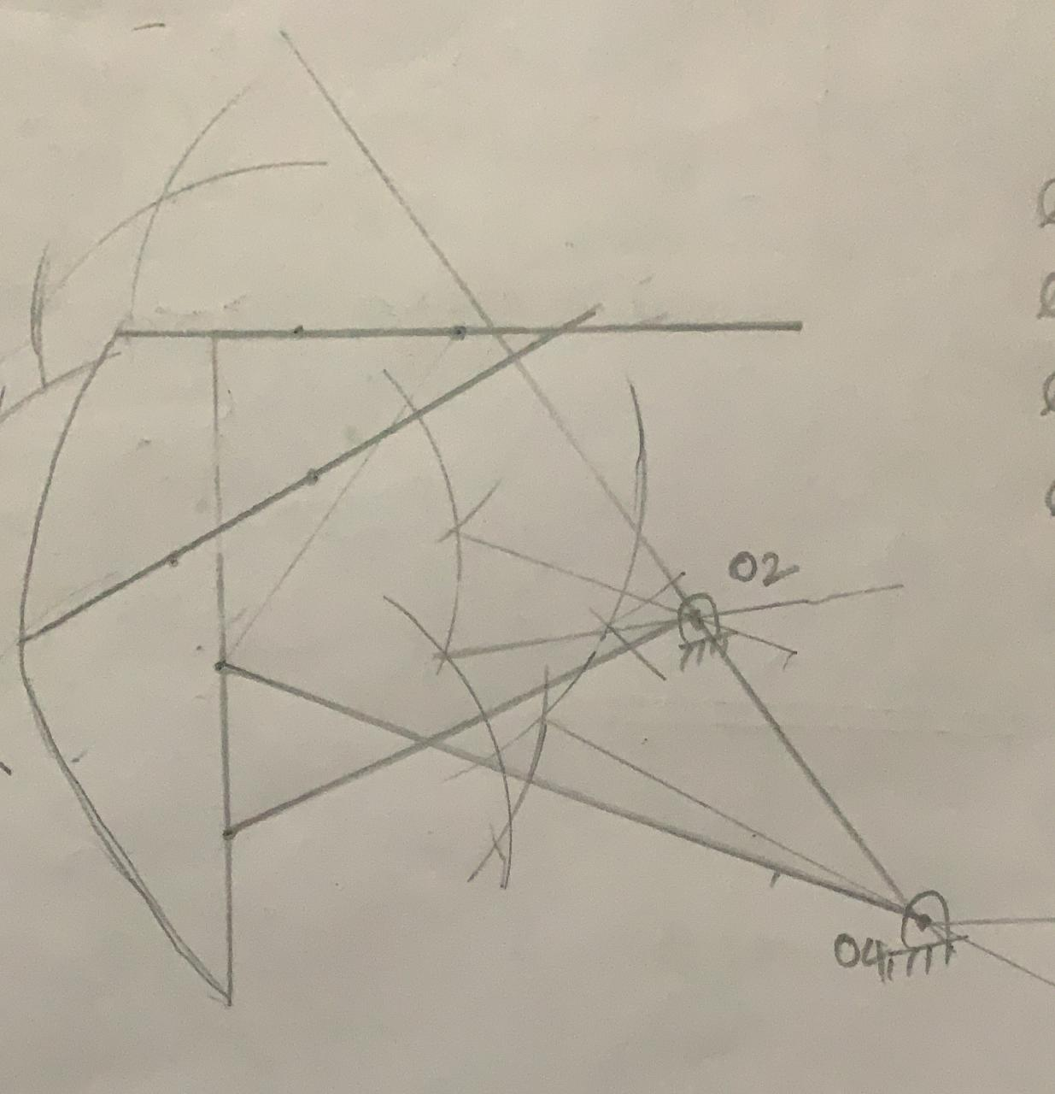
Displacement analysis

Slide 10
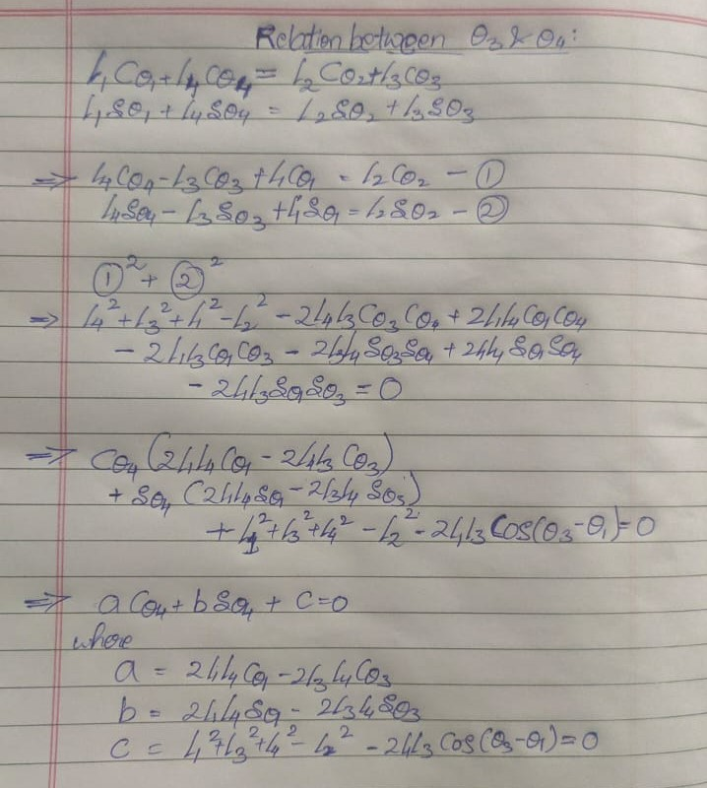
Displacement analysis

Slide 11
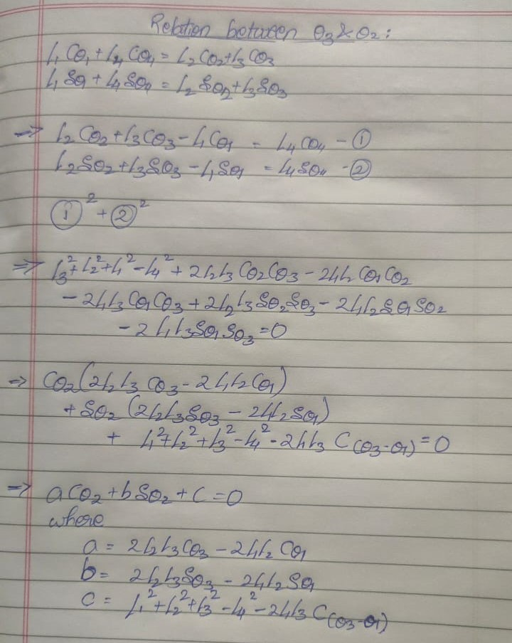
Displacement analysis

Slide 12
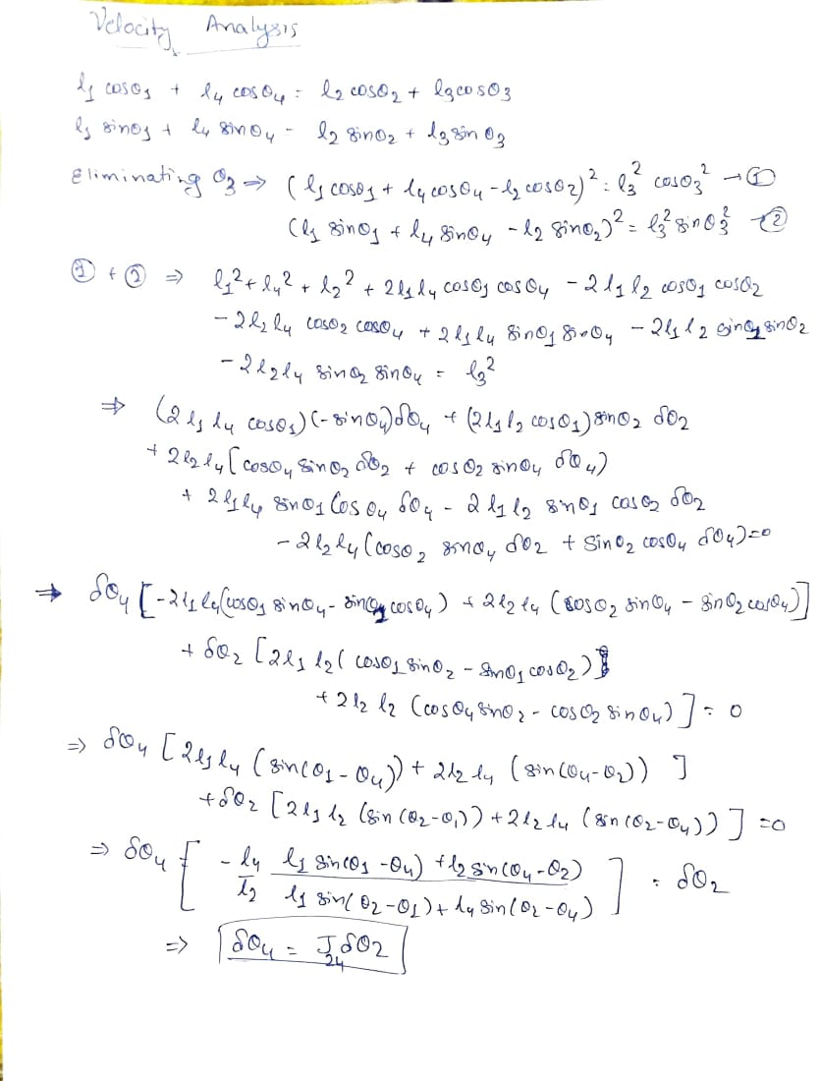
Velocity analysis

Slide 13
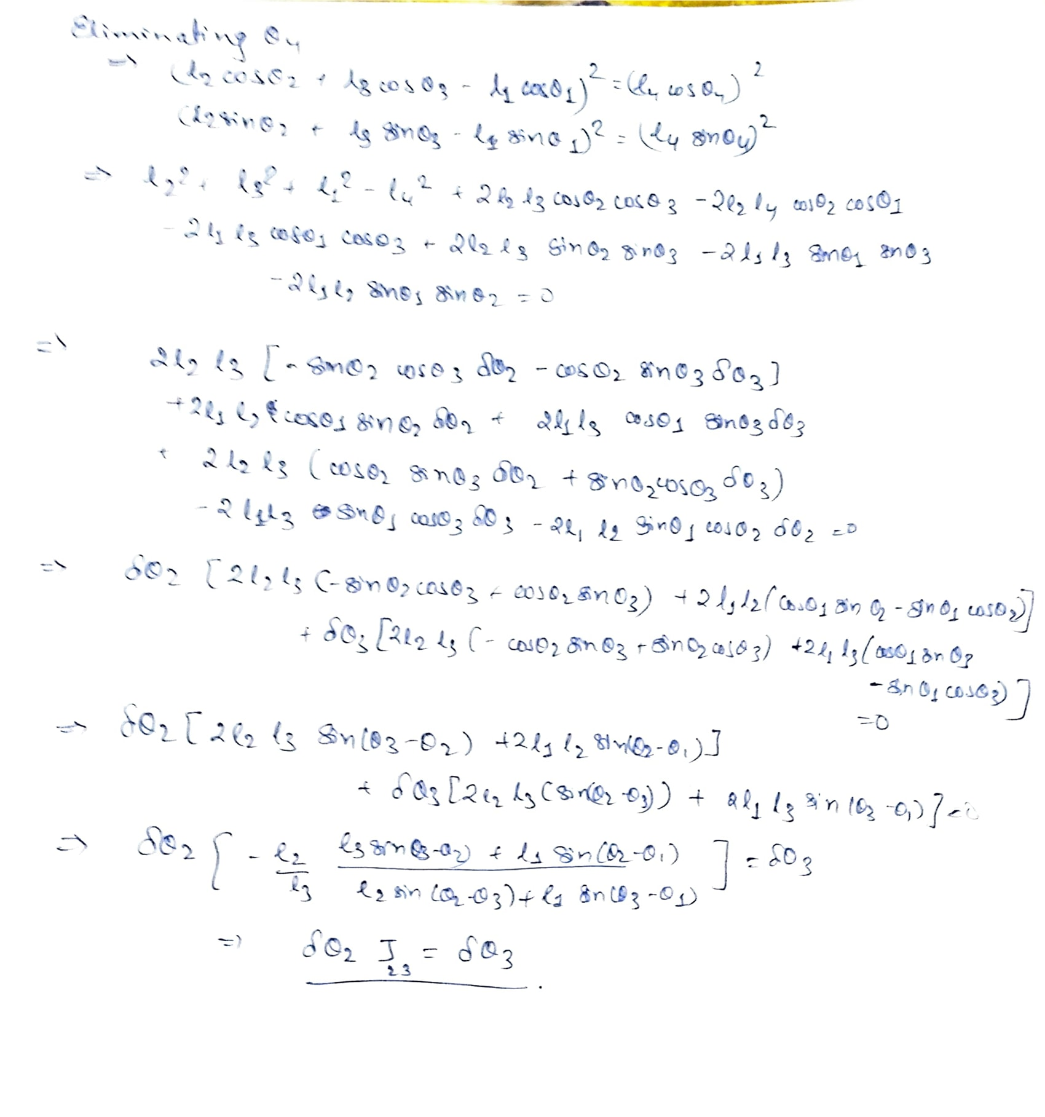
Velocity analysis

